Slide 1
Five HCI Laws for UX Design
Miller’s Law of Short-Term Memory Load
Fitts’ Law
Hick-Hyman Law
Power Law of Practice
Pareto Principle

Slide 2
Fitts’s Law - Users will hit a target faster if it’s big and close to where they start.
Fitts's Law provides a model of human movement, established in 1954 by Paul Fitts, which can accurately predict the amount of time taken to move to and select a target.
Fitts's Law states "...the time to acquire a target is a function of the distance to and size of the target".
As the distance increases, movement takes longer and as the size decreases selection again takes longer.
Whilst Paul Fitts established his law of movement before the advent of graphical user interfaces, the law is no less robust when applied to navigation through the virtual world.
The aim of user interface design should be to reduce the distance from one point to the next and make the target object large enough to enable prompt detection and selection of interactive elements without sacrificing accuracy. One particular aspect of this is ensuring that users are able to click anywhere on an interactive element to carry out the assigned action. For example, links, whether they are in the form of text, images or buttons (, should afford clicking on the whole region.

Slide 3
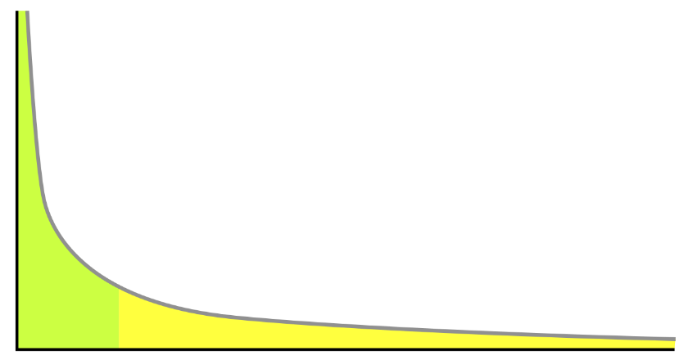
Power Law of Practice - Users do stuff faster the more they practice.
The power law of practice states that the logarithm of the reaction time for a particular task decreases linearly with the logarithm of the number of practice trials taken. It is an example of the learning curve effect on performance. It was first proposed as a psychological law by Snoddy (1928)
Example graph of the power law, x axis represents time, y axis represents reaction time

Slide 4
Pareto principle
The Pareto principle (also known as the 80/20 rule, the law of the vital few, or the principle of factor sparsity)^{[1][2]} states that, for many events, roughly 80% of the effects come from 20% of the causes.
The 80/20 rule – the majority of stuff will be addressed by a minority of things.
(Eg. “A small portion of our site gets hit by a majority of our users.”)

Slide 5
Hick's law - Users will take longer to decide if you give me heaps of choices.
Hick's law, or the Hick–Hyman law, named after British and American psychologists William Edmund Hick and Ray Hyman, describes the time it takes for a person to make a decision as a result of the possible choices he or she has: increasing the number of choices will increase the decision time logarithmically.
The Hick–Hyman law assesses cognitive information capacity in choice reaction experiments. The amount of time taken to process a certain amount of bits in the Hick–Hyman law is known as the rate of gain of information.
Hick's law is sometimes cited to justify menu design decisions.
For example, to find a given word (e.g. the name of a command) in a randomly ordered word list (e.g. a menu), scanning of each word in the list is required, consuming linear time, so Hick's law does not apply.
However, if the list is alphabetical and the user knows the name of the command, he or she may be able to use a subdividing strategy that works in logarithmic time

Slide 6
Miller’s Law- People can only hold up to about 7 pieces of info in short-term memory.
Some Limits on Our Capacity for Processing Information" is one of the most highly cited papers in psychology.
It was published in 1956 in Psychological Review by the cognitive psychologist George A. Miller of Harvard University's Department of Psychology.
It is often interpreted to argue that the number of objects an average human can hold in short-term memory is 7 ± 2. This has occasionally been referred to as Miller's law.
Miller discussed a coincidence between the limits of one-dimensional absolute judgment and the limits of short-term memory.

Slide 7
Miller’s Law- People can only hold up to about 7 pieces of info in short-term memory.
One-dimensional absolute judgment:
In a one-dimensional absolute-judgment task, a person is presented with a number of stimuli that vary on one dimension.
Performance is nearly perfect up to five or six different stimuli but declines as the number of different stimuli is increased.
In a one-dimensional absolute-judgment task, a person is presented with a number of stimuli that vary on one dimension (e.g., 10 different tones varying only in pitch) and responds to each stimulus with a corresponding response (learned before). Performance is nearly perfect up to five or six different stimuli but declines as the number of different stimuli is increased.
The task can be described as one of information transmission:
The input consists of one out of n possible stimuli, and the output consists of one out of n responses.
The information contained in the input can be determined by the number of binary decisions that need to be made to arrive at the selected stimulus, and the same holds for the response.
Therefore, people's maximum performance on one-dimensional absolute judgement can be characterized as an information channel capacity with approximately 2 to 3 bits of information, which corresponds to the ability to distinguish between four and eight alternatives.
Notes:
Stimulus (plural stimuli) is a thing or event that evokes a specific functional reaction in an organ or tissue.

Slide 8
Miller’s Law- People can only hold up to about 7 pieces of info in short-term memory.
Limits of Short term Memory:
The second cognitive limitation Miller discusses is memory span. Memory span refers to the longest list of items (e.g., digits, letters, words) that a person can repeat back in correct order on 50% of trials immediately after presentation.
Miller observed that memory span of young adults is approximately seven items.
He noticed that memory span is approximately the same for stimuli with vastly different amount of information—for instance, binary digits have 1 bit each; decimal digits have 3.32 bits each; words have about 10 bits each.
Miller concluded that memory span is not limited in terms of bits but rather in terms of chunks.
A chunk is the largest meaningful unit in the presented material that the person recognizes—thus, what counts as a chunk depends on the knowledge of the person being tested.
For instance, a word is a single chunk for a speaker of the language but is many chunks for someone who is totally unfamiliar with the language and sees the word as a collection of phonetic segments.

Slide 9
Miller’s Law- People can only hold up to about 7 pieces of info in short-term memory.
Miller recognized that the correspondence between the limits of one-dimensional absolute judgment and of short-term memory span was only a coincidence, because only the first limit, not the second, can be characterized in information-theoretic terms (i.e., as a roughly constant number of bits).
Therefore, there is nothing "magical" about the number seven, and Miller used the expression only linguistically.
Nevertheless, the idea of a "magical number 7" inspired much theorizing, rigorous and less rigorous, about the capacity limits of human cognition.
The number seven constitutes a useful heuristic, reminding us that lists that are much longer than that become significantly harder to remember and process simultaneously.

